Slide 1
Capstone Engagement
Assessment, Analysis, and Hardening of a Vulnerable System

Slide 2
Table of Contents
This document contains the following sections:
01
Network Topology
02
Red Team: Security Assessment
03
Blue Team: Log Analysis and Attack Characterization
Hardening: Proposed Alarms and Mitigation Strategies
04

Slide 3
Network Topology
‹#›

Slide 4
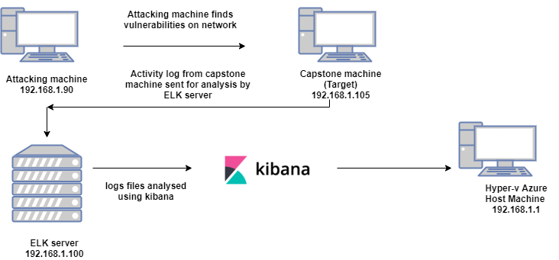
Network Topology
[Insert Here]
Use draw.io to create a diagram of the network.
Add your diagram to this slide and fill out the data in the sidebar.
Network
Address Range:
192.168.1.1-255
Netmask:255.255.255.0
Gateway:192.168.1.1
Machines
IPv4:192.168.1.90
OS: Kali
Hostname: Kali
IPv4: 192.168.1.105
OS: Linux
Hostname: Capstone
IPv4: 192.168.1.100
OS: Linux
Hostname: ELK
IPv4: 198.168.1.1
OS: Windows
Hostname: ML-RefVm-684427

Slide 5

Red Team
Security Assessment
‹#›

Slide 6
Recon: Describing the Target
Nmap identified the following hosts on the network:
Hostname | IP Address | Role on Network
Hyper- V Azure Machine ML-RefVm-684427 | 192.168.1.1 | Host Machine Default Gateway
Kali | 192.168.1.90 | Attacking Machine
ELK Stack | 192.168.1.100 | Kibana Network Monitoring Machine
Capstone | 192.168.1.105 | Target Machine

Slide 7
Vulnerability Assessment
The assessment uncovered the following critical vulnerabilities in the target:
Vulnerability | Description | Impact
LFI Vulnerability | LFI allows access into confidential files on a site | An LFI vulnerability allows attackers to gain access to sensitive credentials
Brute Force Vulnerability | Allow multiple failed authentication attempt on the same account | Using a brute force attack tool, attacker can get the password for the account
Exposing sensitive information Sensitive Data Exposure | Data should be accessible by specific company individuals exposed on the internet | Third party individual can gain access to sensitive and confidential information
Remote Code Execution | Execute shell command on the web server from a remote device. Able to create a reverse shell payload. | Gain direct access into the machine and provide command and control.

Slide 8
Vulnerability Assessment
The assessment uncovered the following critical vulnerabilities in the target:
Vulnerability | Description | Impact
Webdav Vulnerability | Exploit webdav on a server and shell access is possible | If webdav is not configured properly, it can allow hackers to remotely modify website content
Other user’s credentials found when logging on with different user | Storing a user name and password in plain text that is not encrypted | Evidence showed that ashton had ryan’s name and password hash stored.
Unauthorised File upload | It occurs When web applications and websites are not properly validated | The file uploaded will execute malicious script at server side and compromise the security of the web applications.

Slide 9
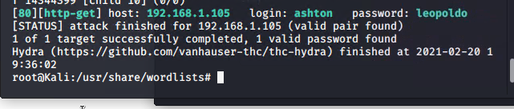
Exploitation: [ Brute Force Vulnerability]
01
02
03
Tools & Processes
How did you exploit the vulnerability? Which tool (Nmap, etc.) or techniques (XSS, etc.) did you use?
Using hydra we ran the command:
Hydra -l -P/usr/share/wordlists/rockyou.txt -s 80 -f -vV 192.168.1.105
http-get/company_folders/secret_folder
Achievements
What did the exploit achieve? For example: Did it grant you a user shell, root access, etc.?
We were able to brute force the credentials for the user ashton and login to the hidden folder as well as the password.

Slide 10
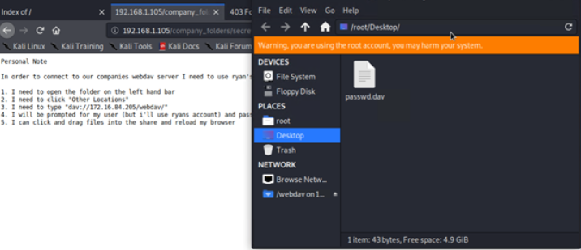
Exploitation: [Sensitive Data Exposure Vulnerability]
01
02
03
Tools & Processes
How did you exploit the vulnerability? Which tool (Nmap, etc.) or techniques (XSS, etc.) did you use?
By navigating the website we used the web browser to navigate the website and see information e.g. company_folder/secret_folder
Achievements
What did the exploit achieve? For example: Did it grant you a user shell, root access, etc.?
We were able to find the url path to the secret folder and gain information about high level personnel in the company, and who had access to the secret folder.
[INSERT: screenshot or command output illustrating the exploit.]
Notes:
Achievements
What did the exploit achieve? For example: Did it grant you a user shell, root access, etc.?
We were able to find the url path to the secret folder and gain information about high level personnel in the company, and who had access to the secret folder.

Slide 11
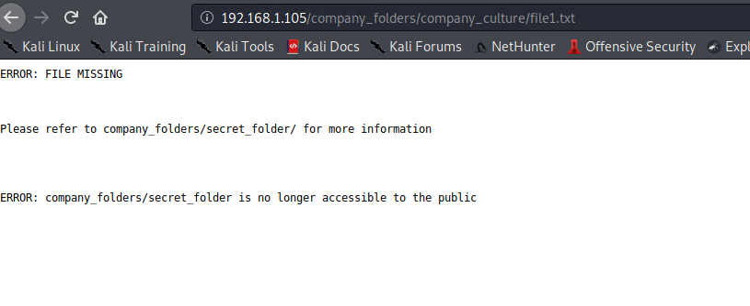
Exploitation: [Directory]
01
02
03
Tools & Processes
How did you exploit the vulnerability? Which tool (Nmap, etc.) or techniques (XSS, etc.) did you use?
Use nmap to scan network nmap sV -v 192.168.1.105
Notice in ashton ,s he referred secret_folder he manages.
Achievements
What did the exploit achieve? For example: Did it grant you a user shell, root access, etc.?
We were able to browse all company resources and find unlisted directories.

Slide 12
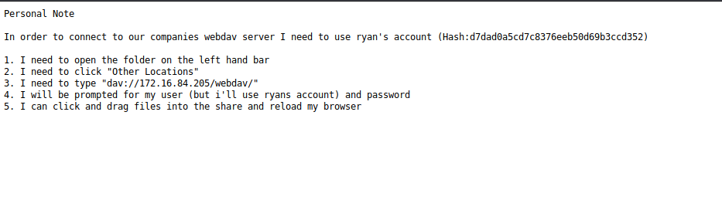
Exploitation: [Hashed Password]
01
02
03
Tools & Processes
How did you exploit the vulnerability? Which tool (Nmap, etc.) or techniques (XSS, etc.) did you use?
Cracked the hashed password by using the website crackstation.net
Achievements
What did the exploit achieve? For example: Did it grant you a user shell, root access, etc.?
Achieved the password with the username ryan to access /webdav folder
[INSERT: screenshot or command output illustrating the exploit.]

Slide 13
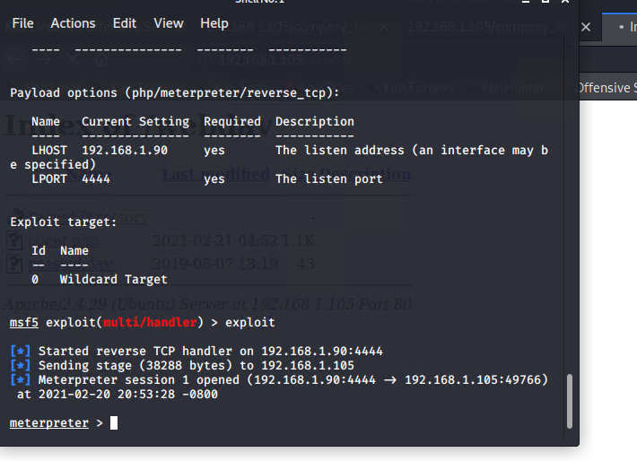
Exploitation: [LFI Vulnerability]
01
02
03
Tools & Processes
How did you exploit the vulnerability? Which tool (Nmap, etc.) or techniques (XSS, etc.) did you use?
Using the dirb tool we were able to find the urls on the capstone/server1 website
Achievements
What did the exploit achieve? For example: Did it grant you a user shell, root access, etc.?
Using the multi/handler exploit , we get access to the shell.
[INSERT: screenshot or command output illustrating the exploit.]

Slide 14
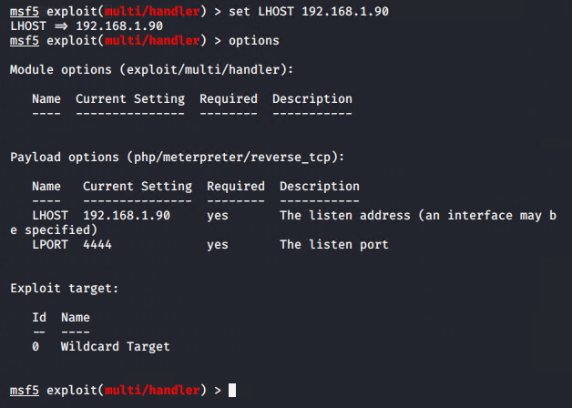
Exploitation: [Reverse shell]
01
02
03
Tools & Processes
How did you exploit the vulnerability?
created and uploaded msfvenom payload
Achievements
What did the exploit achieve?
Opened a backdoor shell in the capstone server to gain sudo access.
[INSERT: screenshot or command output illustrating the exploit.]

Slide 15

Blue Team
Log Analysis and Attack Characterization
‹#›

Slide 16

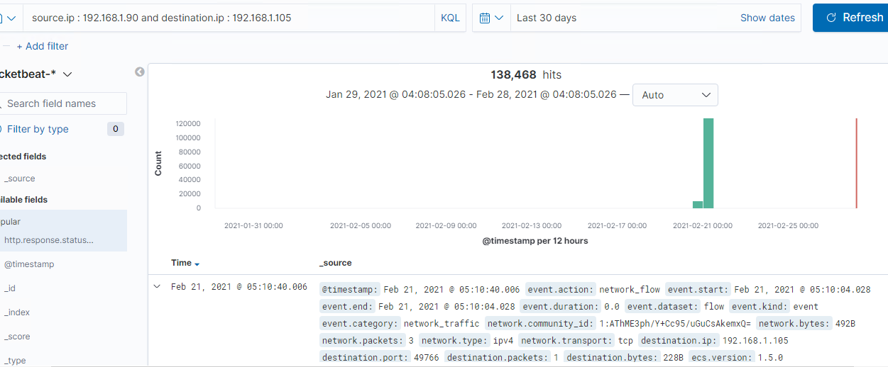
Analysis: Identifying the Port Scan
Answer the following questions in bullet points under the screenshot if space allows. Otherwise, add the answers to speaker notes.
What time did the port scan occur?
How many packets were sent, and from which IP?
What indicates that this was a port scan?
[Insert Here]
Include a screenshot of Kibana logs depicting the port scan.
Notes:
What time did the port scan occur? At 5:10 on feb 21, 2021
How many packets were sent, and from which IP? 138,468 packets were sent, the source ip was 192.168.1.90
What indicates that this was a port scan? Sudden peak in network traffic indicates that this was a port scan. Destination port 80 www http

Slide 17
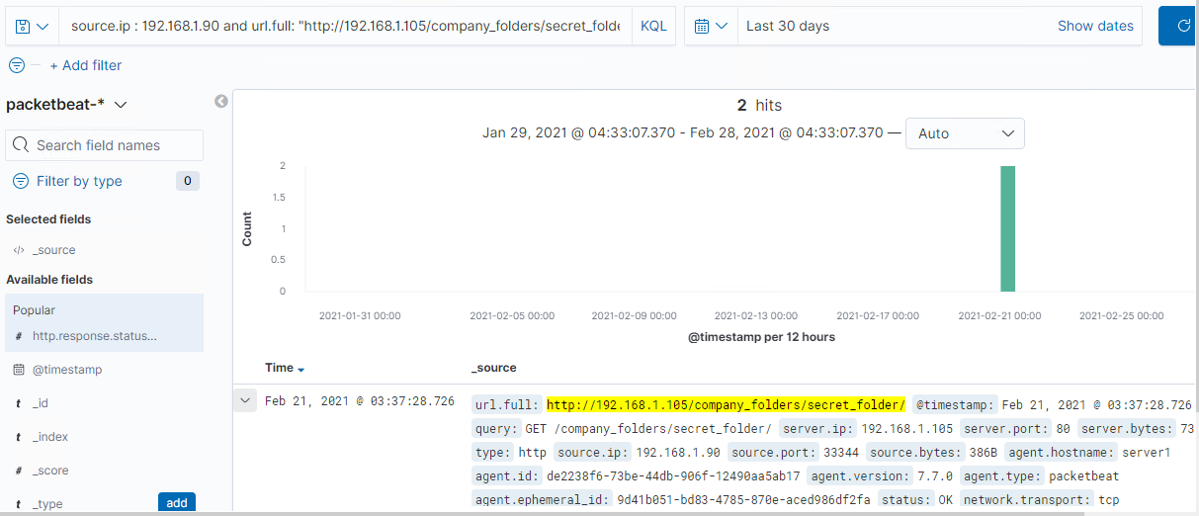
Analysis: Finding the Request for the Hidden Directory
Answer the following questions in bullet points under the screenshot if space allows. Otherwise, add the answers to speaker notes.
What time did the request occur?
How many requests were made?
Which files were requested?
What did they contain?
[Insert Here]
Include a screenshot of Kibana logs depicting the request for the hidden directory.
Notes:
What time did the request occur? At 03:37 on feb 21 2021
How many requests were made? Based on the dates 2 hits.
Which files were requested? /secret_folder
What did they contain? Contained a hash to be used to access the system using credentials of ryan

Slide 18
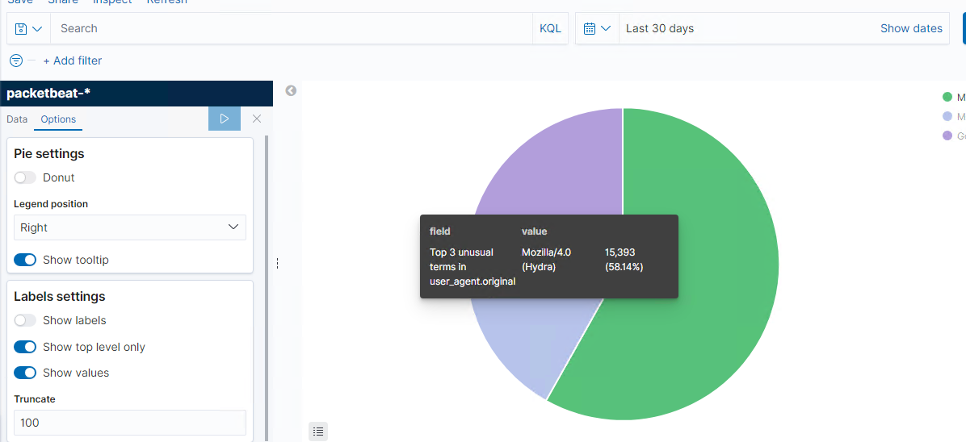
Analysis: Uncovering the Brute Force Attack
Answer the following questions in bullet points under the screenshot if space allows. Otherwise, add the answers to speaker notes.
How many requests were made in the attack?
How many requests had been made before the attacker discovered the password?
[Insert Here]
Include a screenshot of Kibana logs depicting the brute force attack.
Notes:
How many requests were made in the attack?15,393 requests were made in the brute force attack.
How many requests had been made before the attacker discovered the password? Network Traffic showed 119,536 requests being sent from the attacker ip 192.168.1.90 correlation between the attack and discovering the correct password.

Slide 19
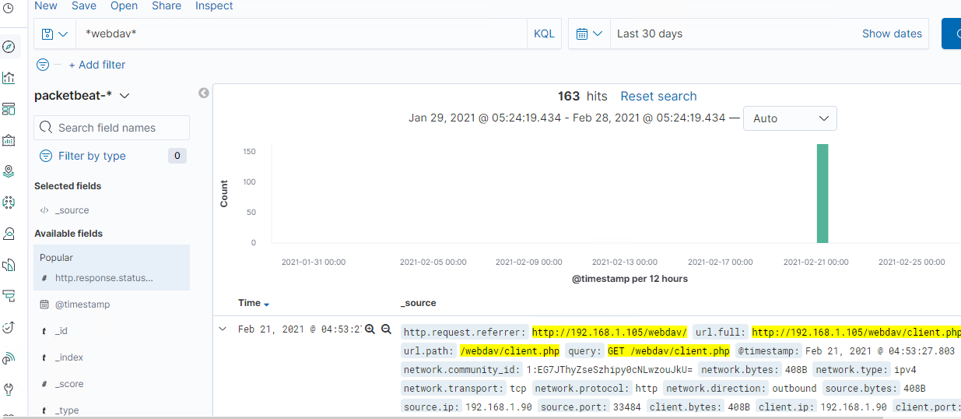
Analysis: Finding the WebDAV Connection
Answer the following questions in bullet points under the screenshot if space allows. Otherwise, add the answers to speaker notes.
How many requests were made to this directory?
Which files were requested?
[Insert Here]
Add a screenshot of Kibana logs depicting the WebDAV connection.
Notes:
How many requests were made to this directory?163 requests
Which files were requested?http://192.168.1.105/webdav/client.php

Slide 20
Blue Team
Proposed Alarms and Mitigation Strategies
‹#›

Slide 21
Mitigation: Blocking the Port Scan
What kind of alarm can be set to detect future port scans?
Having a TCP wrapper can give administrators the flexibility to permit or deny access.
The alarms for high number of half open connection from the same source IP
10 connection/second from one host to another would be reasonable starting point.
What configurations can be set on the host to mitigate port scans?
Firewall denies access to IPs that generate too many request for half open connections.
Ensure the firewall is regularly patches to minimize new zero day attacks.
Firewall detects and cuts off the scan attempt in real time.
Disable ICMP
Iptables -I INPUT -p icmp --icmp-type echo-request -j DROP

Slide 22
Mitigation: Finding the Request for the Hidden Directory
What kind of alarm can be set to detect future unauthorized access?
Send an alarm every time when someone attempts to access the directory from an unauthorized ip address
What threshold would you set to activate this alarm?
A threshold of 3 attempts that would trigger an alert to be sent.
What configuration can be set on the host to block unwanted access?
Create WAF to protect secret_folder from unauthorised access.
Highly confidential folders should not be shared for public access.
Review ip address that cause an alert to be sent.

Slide 23
Mitigation: Preventing Brute Force Attacks
What kind of alarm can be set to detect future brute force attacks?
Alarm for too many unauthorised access
What threshold would you set to activate this alarm?
Threshold 10
What configuration can be set on the host to block brute force attacks?
Implement multi factor authentication complex username and password policies account lockout after 5 attempts.
Lock out authentication attempts if anyone browses

Slide 24
Mitigation: Detecting the WebDAV Connection
What kind of alarm can be set to detect future access to this directory?
Send an alarm every time webdav appears in ELK logs or accessing the directory
What threshold would you set to activate this alarm?
When any HTTP put request is made.
2 would set
What configuration can be set on the host to control access?
Less access to users and allow only specific users.
Ensure firewall security policy prevents all other access.
Any access to the webdav folder is only permitted by users with complex username and passwords.. This will help lessen the amount of access to certain areas of the system.

Slide 25
Mitigation: Identifying Reverse Shell Uploads
What kind of alarm can be set to detect future file uploads?
An alert be set for any traffic attempting to access port 4444.
What threshold would you set to activate this alarm?
When 2 attempts are made.
What configuration can be set on the host to block file uploads?
Ensure Only necessary ports are open.
Make sur only trusted users having privileges .
Set access to the webdav to read only to prevent payloads from being uploaded.
Remove all unnecessary tools and interpreters to prevent the execution of atleat some shell codes.

